Slide 1


Computer Architecture Spring 2020
Hamed Farbeh
farbeh@aut.ac.ir
Department of Computer Engineering
Amirkabir University of Technology

Slide 2
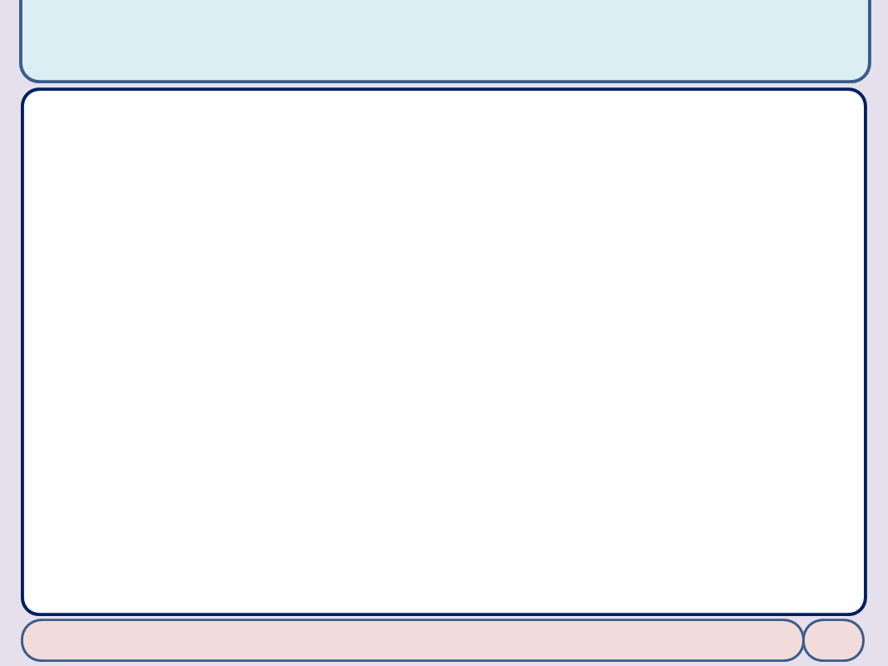

Copyright Notice
Lectures adopted from
Computer Organization and Design: The Hardware/Software Interface, 5th edition, David A. Patterson, John L. Hennessy, MK pub., 2014
Chapter 5: Large and Fast: Exploiting Memory Hierarchy
Computer Architecture, Spring 2020, AUT, Tehran, Iran

Slide 3
Replacement Policy
Direct mapped: no choice
Set associative
Prefer non-valid entry, if there is one
Otherwise, choose among entries in the set
Cache replacement policies (algorithms)
Computer Architecture, Spring 2020, AUT, Tehran, Iran

Slide 4
Replacement Policy
Cache replacement policies (algorithms)
Bélády's optimal algorithm (or simply optimal)
FIFO
LIFO (or FILO)
Most-recently used (MRU)
Random
Least-recently used (LRU)
Bélády's anomaly
The phenomenon in which increasing the number of blocks results in an increase in the number of misses for certain memory access patterns
Fine more: https://en.wikipedia.org/wiki/Cache_replacement_policies
Computer Architecture, Spring 2020, AUT, Tehran, Iran

Slide 5
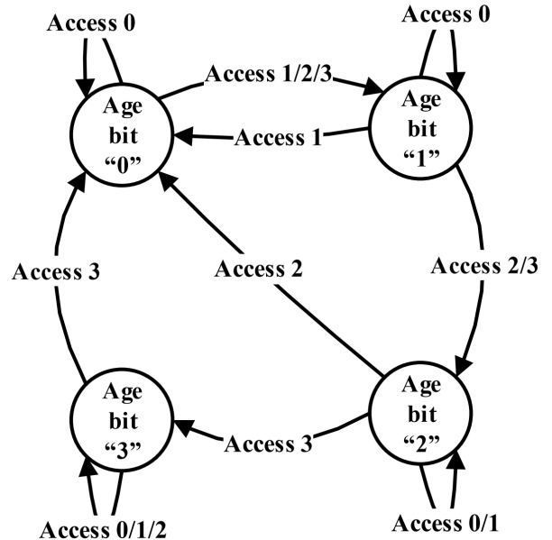
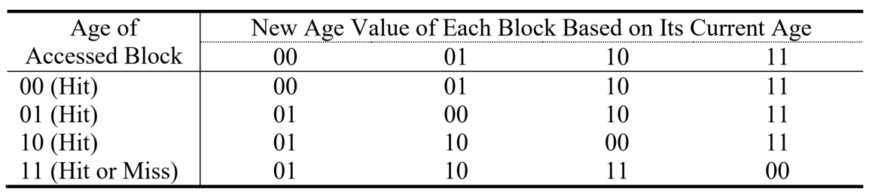
LRU Replacement Policy
Age bits: show the accesses order
Number of bits per block: Log n for n-way cache
Computer Architecture, Spring 2020, AUT, Tehran, Iran

